Slide 1
On Power Laws in Deep Ensembles
Author: Ekaterina Lobacheva, Nadezhda Chirkova, Maxim Kodryan, Dmitry Vetrov
Presented by: Tianyu Zhang & Yusong Wu

Slide 2
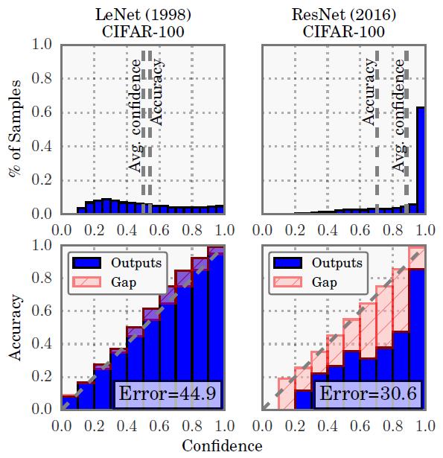
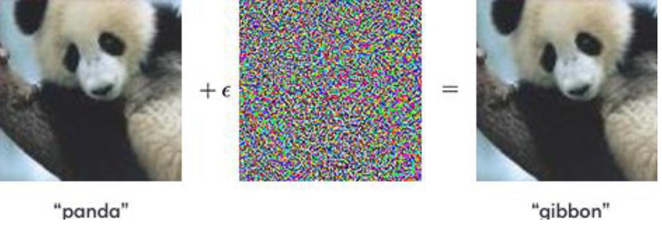

Introduction
Limitation of neural networks
Overconfidence
Vulnerability to adversarial attacks
Overfitting
Ensemble works but what do we do when resources are limited (fixed)
Metric of the quality of uncertainty estimation
calibrated negative log-likelihood

Slide 3
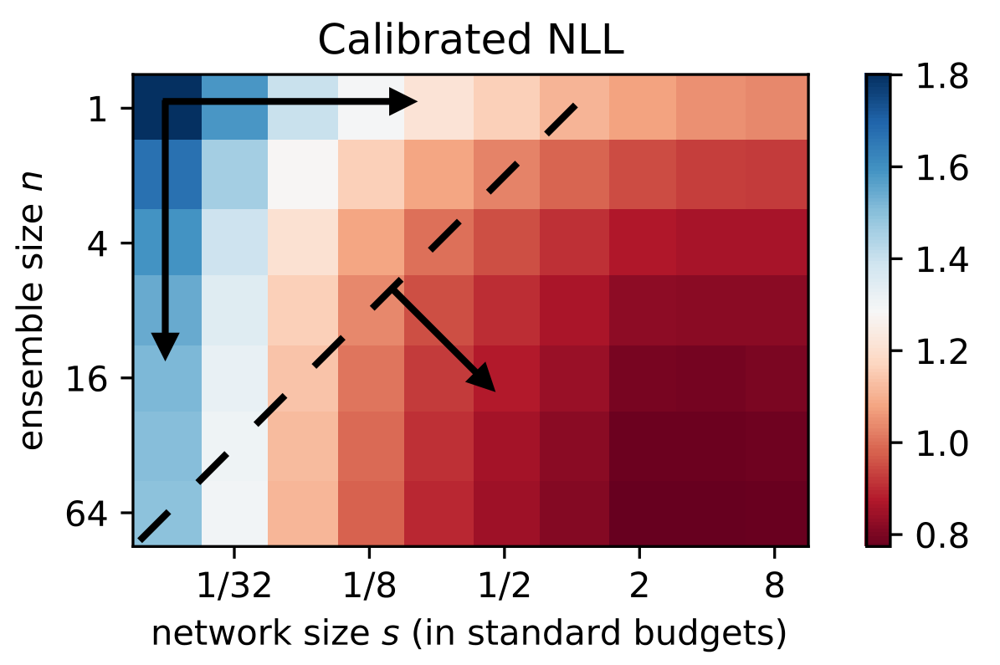
Introduction
Fix the network size s + increase the ensemble size n
Fix the ensemble size n + increase the network size s
Fix the ratio between the network size s and the ensemble size n + increase total number of parameters

Slide 4
Contributions
Derive the conditions under which CNLL follows a power law
Present the power laws on the whole considered range of their arguments
CNLL(n), n is the ensemble size
CNLL(s), s is the network size
CNLL(m), m is the total parameter count
Make important conclusions: given fixed resources 1 large NN < more small NN
CNLL power laws and the optimal memory split can be predicted

Slide 5


Notations
[def] Power Law
X
X
X
X
[def] the Optimal Memory Split: given fixed budget, the best way to balance (split) ensemble size n and the network size s

Slide 6
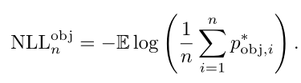


Theoretical view
The model-average NLL of an ensemble of size n for the given object

Slide 7
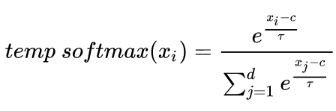
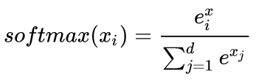
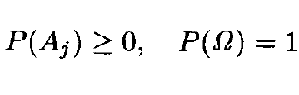

Theoretical view
X
The comparison of the NLLs of different models with suboptimal softmax temperature may lead to an arbitrary ranking of the models
The comparison should only be performed after calibration

Slide 8
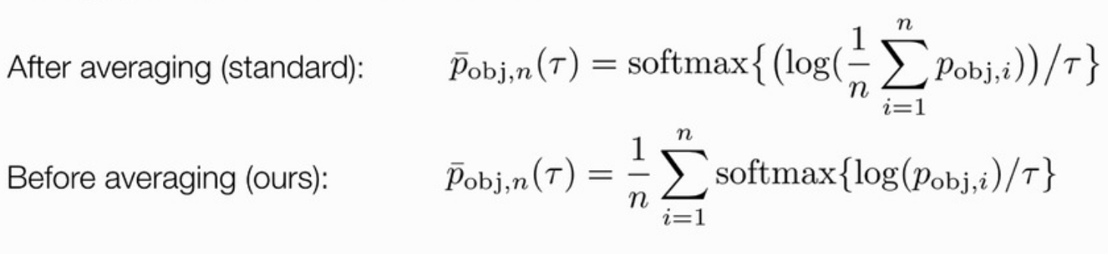
Theoretical view

Slide 9



Theoretical view
the difference between the values of LE-NLLn and CNLLn is negligible in practice.

Slide 10
Experiments Setup
Networks: WideResNet, VGG16
Datasets: CIFAR-10, CIFAR-100
Network size change: filter width and fully-connect neurons
Standard configuration: 15.3M / 36.8M parameters
Training details:
Grid search weight decay and dropout for every network
Batch size of 128, 200 epochs, annealing learning schedule
Train multiple groups of ensembles and average performance

Slide 11
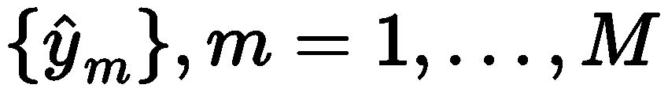
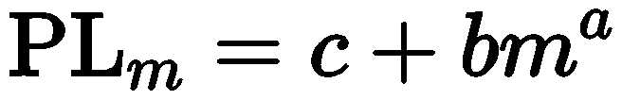
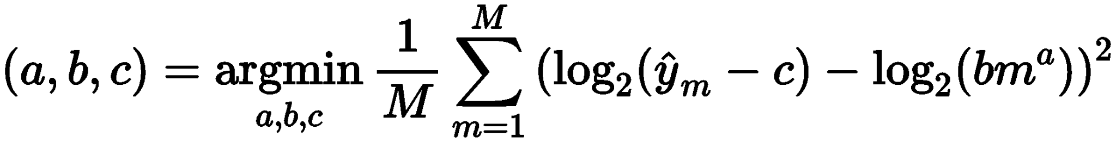
Approximating Power Law
Given sequence of data points:
Fit in power law:
Finding a,b,c: optimize following objective using BFGS:
Equivalent to fitting the linear regression model in log space

Slide 12
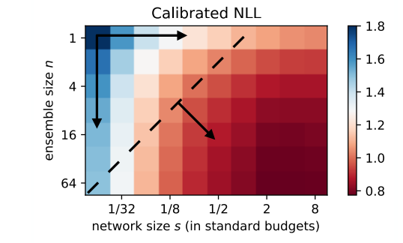
Experiment Questions
Factors:
Ensemble size
Network size
Number of parameters
Performance metrics:
NLL
CNLL
Goal:
Is there power law between factors and performance metrics?
If so, how effective it is for each pair?
Can we predict with power law to find optimal ensemble?

Slide 13
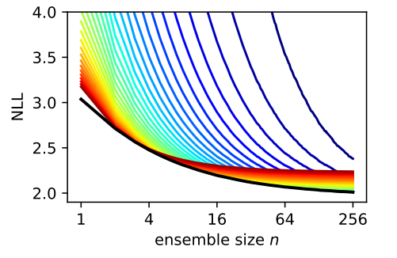
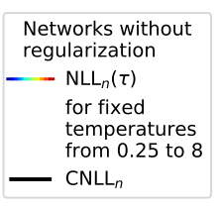
NLL - Ensemble Size
NLL &CNLL - ensemble size has power law in all cases
CNLL is very close to lower envelope of NLL
(VGG on CIFAR-100)

Slide 14
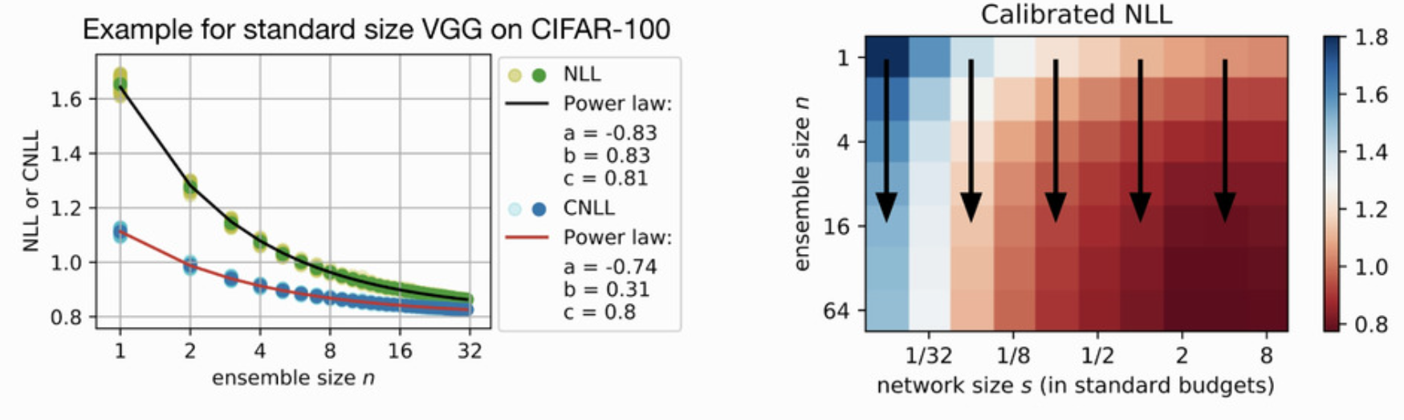
NLL - Ensemble Size
NLL &CNLL - ensemble size has power law in all cases

Slide 15
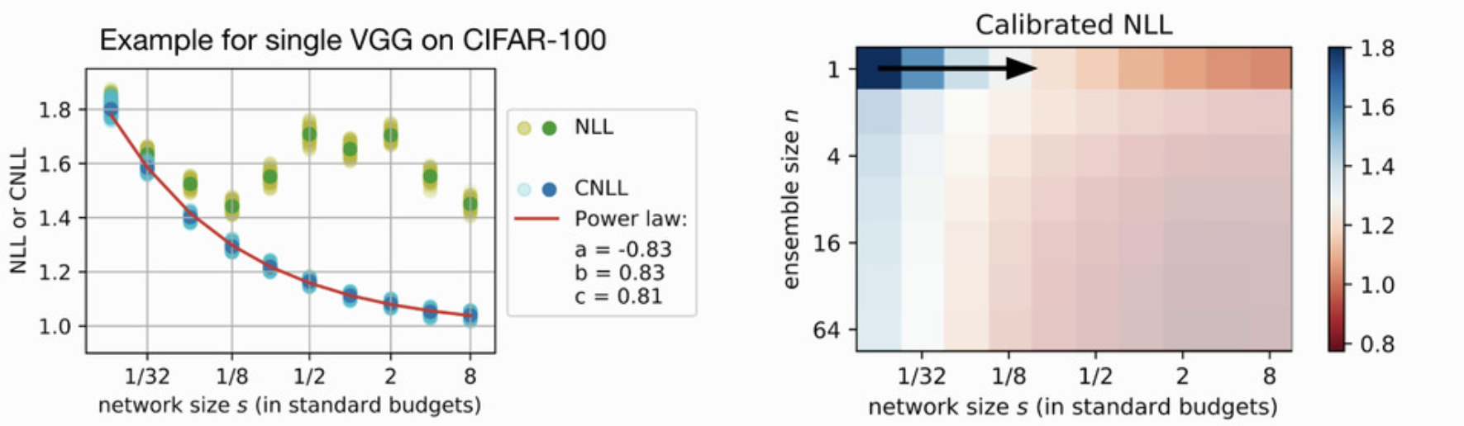
NLL - Network Size, single network
CNLL - network size has power law
NLL - network size does not have power law (double descent)

Slide 16
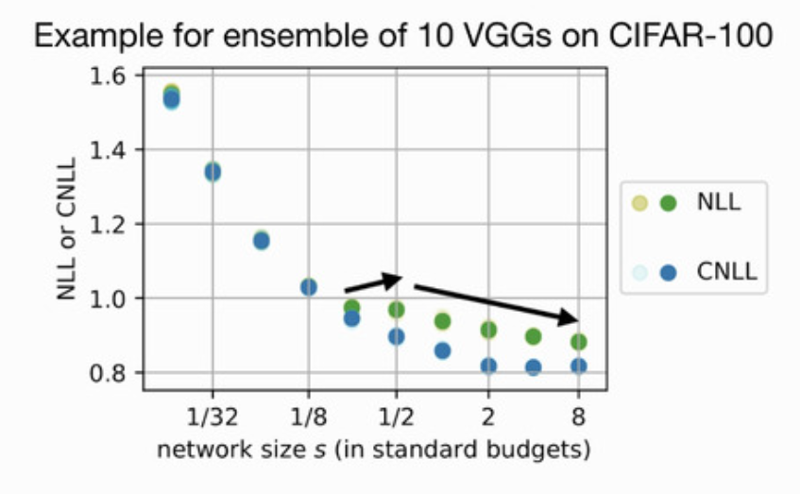
NLL - Network Size, multiple networks
NLL&CNLL - network size does not has power law
Larger networks starts have increasing CNLL
Probably due to lack of regularization

Slide 17
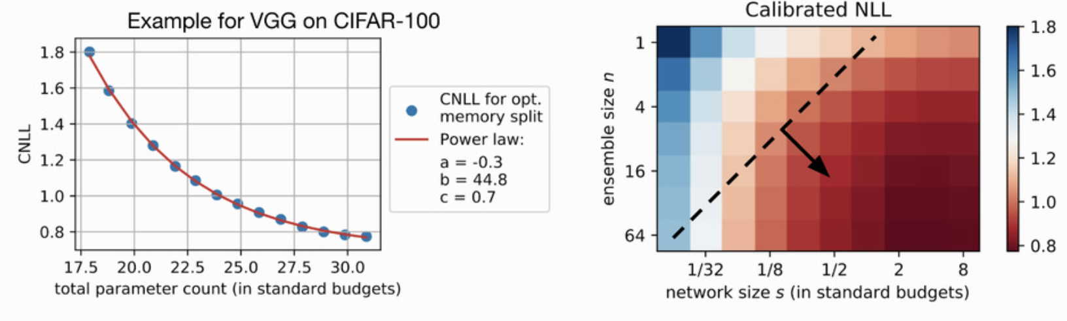
NLL - Parameter Count
CNLL - parameter count has power law

Slide 18
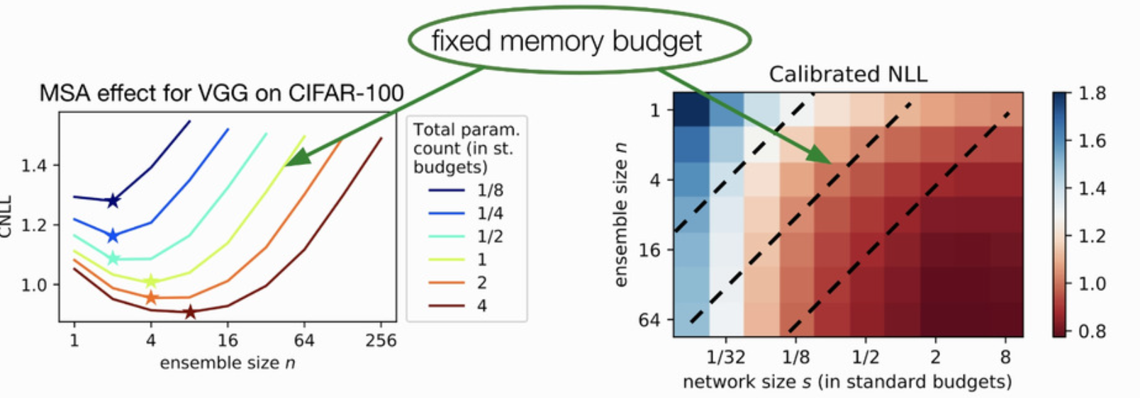
NLL - Parameter Count
Fior a fixed memory budget, there is an optimal point
Train one large network < train ensemble of small networks
Also apply for accuracy

Slide 19
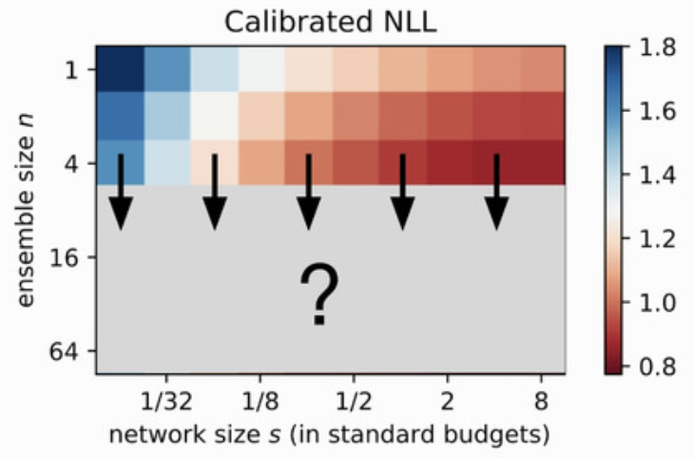
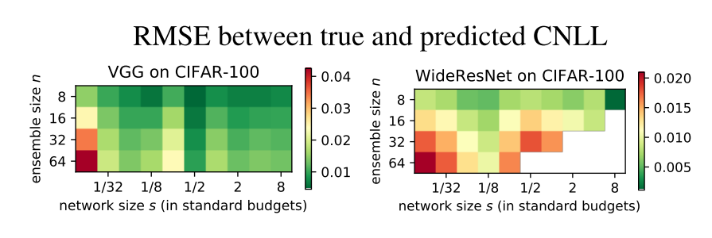
Prediction Using Power Laws
CNLL can be accurately predicted

Slide 20
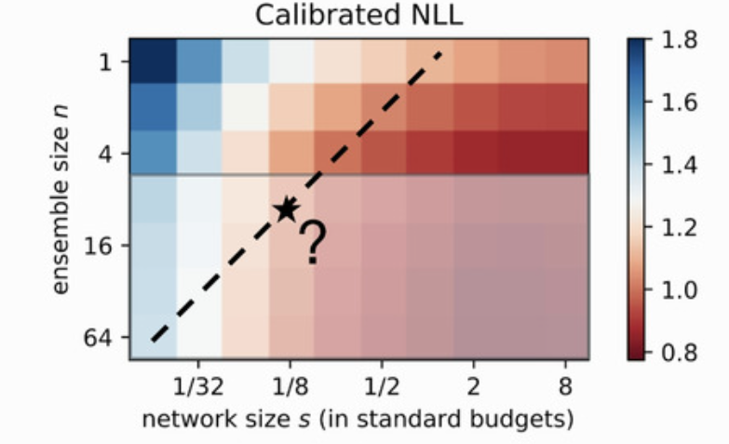
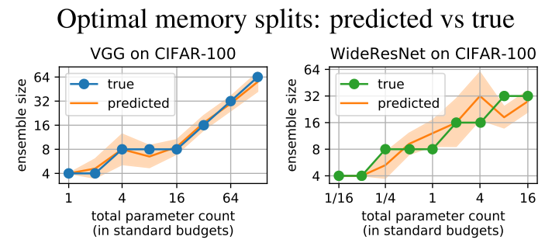
Prediction Using Power Laws
Optimal ensemble can be predicted accurately

Slide 21
Conclusion
The CNLL as a function of n follows a power law on the wide finite range of n, starting from n = 1, but with the power parameter slightly higher than the one derived theoretically
The CNLL of a single network follows a power law as a function of the network size s on the whole reasonable range of network sizes, with the power parameter approximately the same as derived
The CNLL also follows a power law as a function of the total parameter count (memory budget)
For a given memory budget, the number of networks in the optimal memory split is usually much higher than one, and can be predicted using the discovered power laws.

Slide 22
Questions?

